Slide 1

Signature Verification System
Django-Based Application Using Deep Learning Neural Networks
Presented by Shaik Muskan

Slide 2
Introduction
What is Signature Verification?
The process of determining the authenticity of a signature.
Why is it important?
Used in banking, legal systems, and document verification to prevent fraud.

Slide 3
Objective
Main Aim:
To develop a system that detects whether a signature is forged or real.
Key Features:
Backend: Django (Python)
Frontend: HTML & CSS
Integration of Deep Learning Models for prediction.

Slide 4
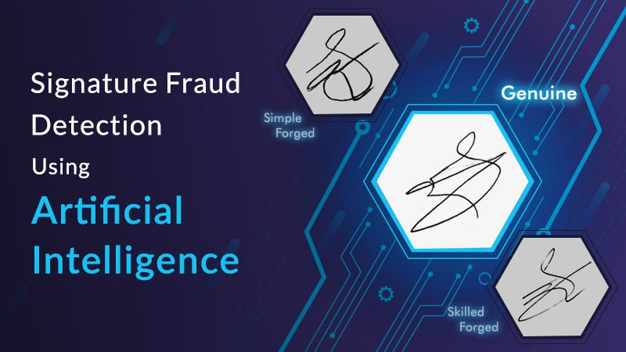
System Workflow
User uploads a signature image.
The system preprocesses the image.
Deep learning models analyze the signature.
Prediction and accuracy are displayed.
Input
image

Slide 5
Technologies Used
Backend: Django (Python)
Frontend: HTML, CSS
Deep Learning Frameworks:
Neural Networks: CNN, RNN, CRNN, BiLSTM, BiRNN
Database: SQLite/MySQL
Libraries: OpenCV, NumPy, scikit-learn

Slide 6
Deep Learning Models Used
CNN (Convolutional Neural Network):
Extracts spatial features from the signature image.
RNN (Recurrent Neural Network):
Processes sequential data from features extracted.
CRNN (Convolutional Recurrent Neural Network):
Combines CNN and RNN for better accuracy.
BiLSTM & BiRNN (Bidirectional LSTM/RNN):
Captures context from both forward and backward passes for
improved results.

Slide 7
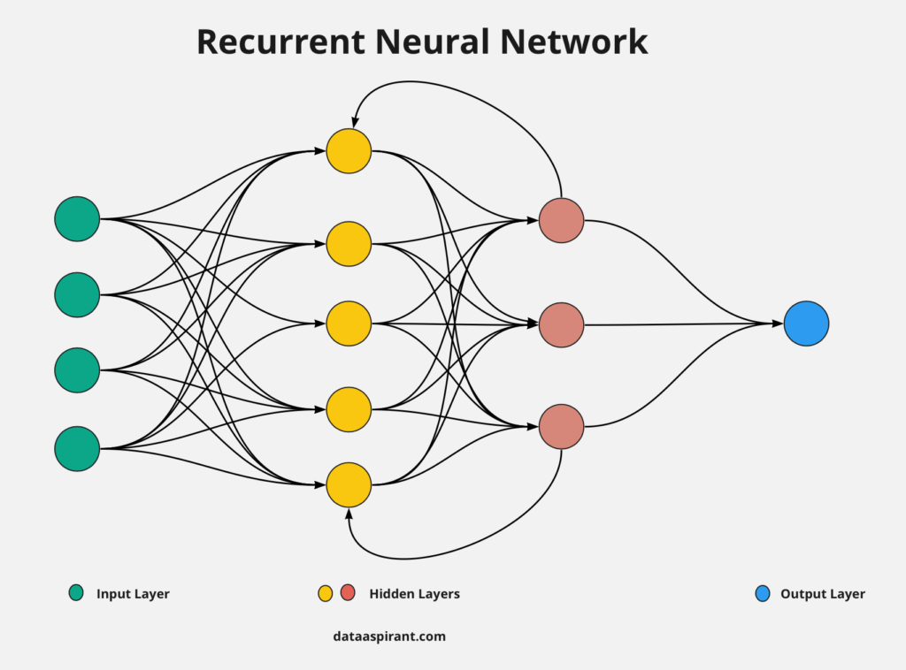
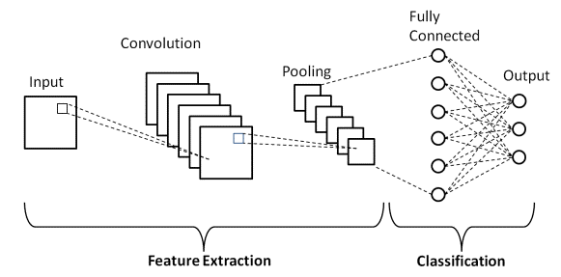
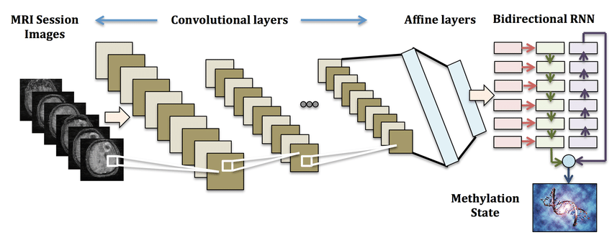
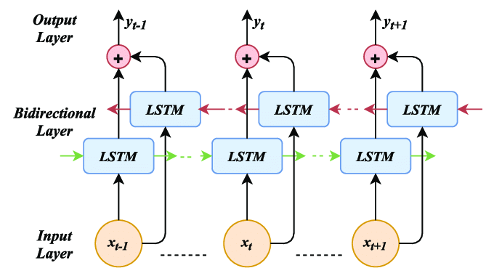
Architectures
Convolutional Neural Network
CRNN
Bi LSTM

Slide 8
Key Features of the System
User-Friendly Interface:
Simple upload functionality.
Accurate Predictions:
Deep learning models ensure precision.
Real-Time Analysis:
Processes signatures quickly and efficiently.
Secure and Scalable:
Django ensures security and scalability.

Slide 9
Results Display
Output Shown to Users:
Uploaded image.
Prediction: Real or Forged.
Accuracy (%).
Format:
Displayed in a table on the results page.

Slide 10
Applications
Real-World Use Cases:
Banking and Financial Sectors.
Document Verification for Legal Purposes.
Fraud Prevention in Corporate Systems.
Educational Institutions for Certification.

Slide 11
Conclusion and Future Scope
Conclusion:
The Signature Verification System offers a robust method
to detect forged signatures using deep learning models.
Future Enhancements:
Incorporate more advanced models for higher accuracy.
Extend the system to include multilingual signature
datasets.
Deploy the project for real-world usage via web hosting.

Slide 12
Thank You

